Slide 1
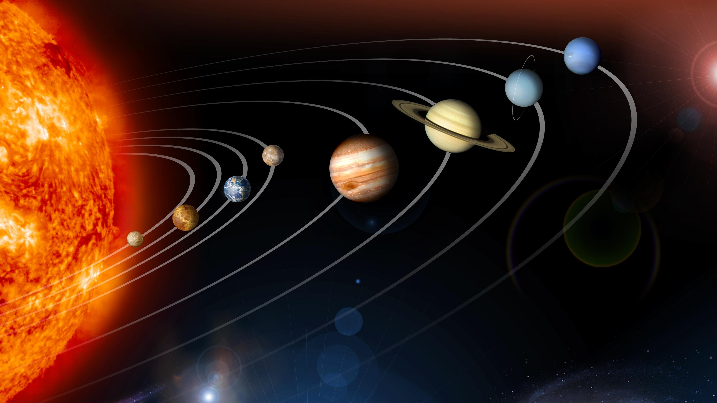
The Solar System
Lim Li Xin Jed

Slide 2
1
Planets
Sorry Pluto☹
2
Asteroid Belt
It killed the dinosaurs
3
Kuiper Belt
Beyond Neptune
4
Oort Cloud
Edge of the Solar System
Planets
Asteroid Belt
Kuiper Belt
Oort Cloud
Notes:
Here are my contents for today. (click)

Slide 3
Planets
Planets
Asteroid Belt
Kuiper Belt
Oort Cloud
Notes:
First, let us go through some basics. (click)

Slide 4
What is a planet?
A planet is a celestial body that:
is in orbit around the Sun
has sufficient mass for its self-gravity to make it round
has cleared the neighbourhood around its orbit
Planets
Asteroid Belt
Kuiper Belt
Oort Cloud
Notes:
This is my experimental setup. (click) A signal generator is used to generate a signal that passed to (click) the speaker which plays the sound. (click) The disk is placed in front of the speaker and (click A decibel meter is used to accurately measure the intensity of the sound which is stored by (click) the datalogger. (click) The motion of the disk is recorded by a camera. (click)

Slide 5
Solar System
*not to scale (obviously)
Notes:
This is my experimental setup. (click) A signal generator is used to generate a signal that passed to (click) the speaker which plays the sound. (click) The disk is placed in front of the speaker and (click A decibel meter is used to accurately measure the intensity of the sound which is stored by (click) the datalogger. (click) The motion of the disk is recorded by a camera. (click)

Slide 6
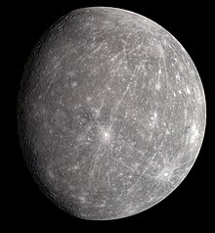
Mercury
Named after the Roman God of War
Closest planet to the sun – tidal locking
Smallest planet in the Solar System
Lack of an atmosphere
Geologically inactive
Craters
Planets
Asteroid Belt
Kuiper Belt
Oort Cloud
Notes:
This is my experimental setup. (click) A signal generator is used to generate a signal that passed to (click) the speaker which plays the sound. (click) The disk is placed in front of the speaker and (click A decibel meter is used to accurately measure the intensity of the sound which is stored by (click) the datalogger. (click) The motion of the disk is recorded by a camera. (click)

Slide 7
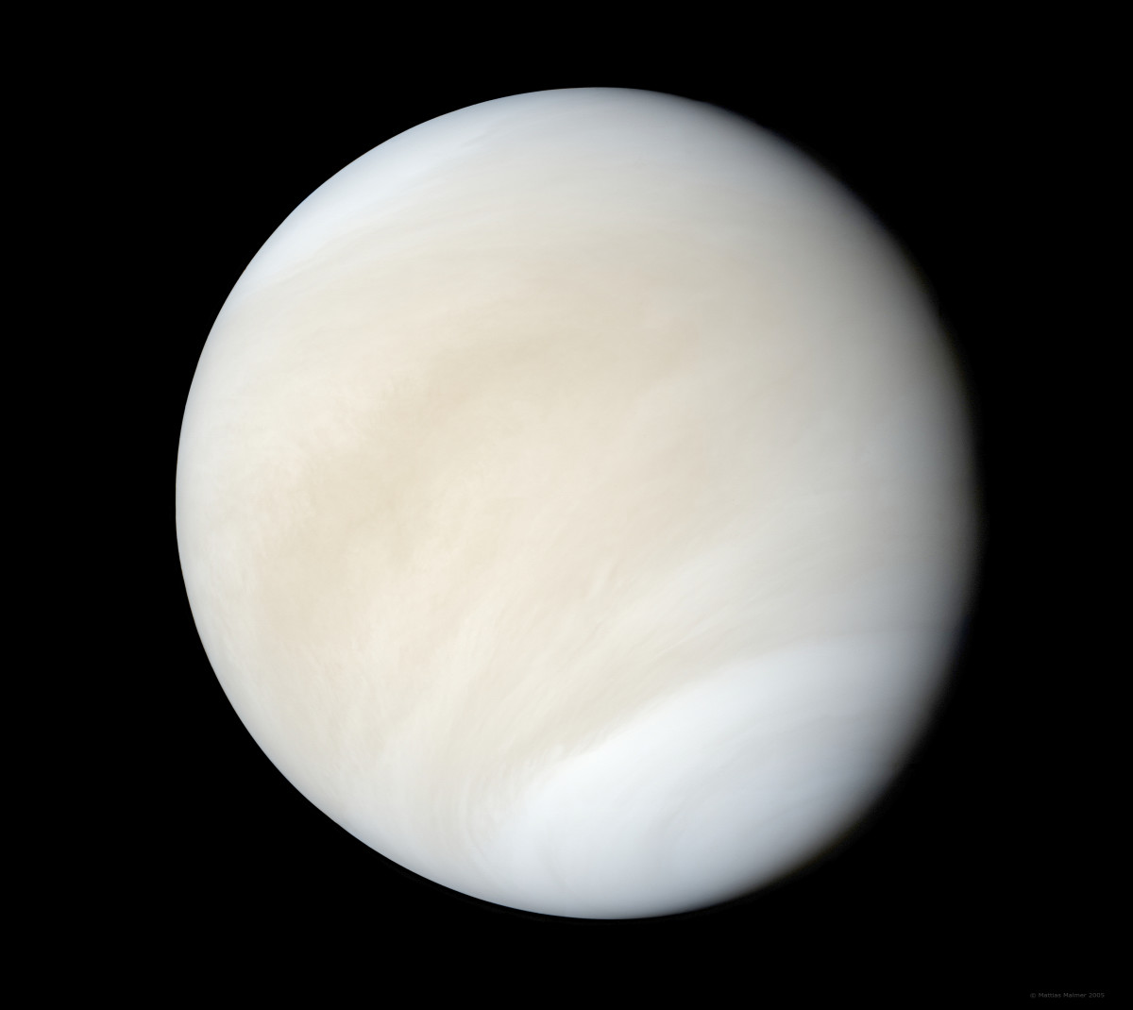
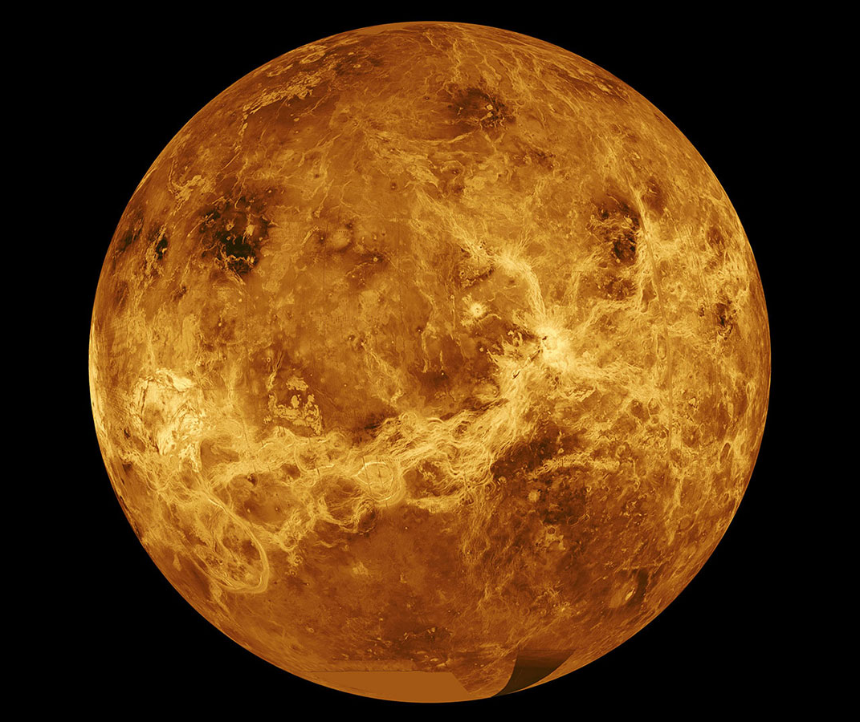
Venus
True Colour
False Colour
What it looks like in visible light
What it looks like under other wavelengths of light
Planets
Asteroid Belt
Kuiper Belt
Oort Cloud
Notes:
This is my experimental setup. (click) A signal generator is used to generate a signal that passed to (click) the speaker which plays the sound. (click) The disk is placed in front of the speaker and (click A decibel meter is used to accurately measure the intensity of the sound which is stored by (click) the datalogger. (click) The motion of the disk is recorded by a camera. (click)

Slide 8
Venus
Named after the Roman goddess of love and beauty
Brightest night sky object (other than the Moon)
Atmospheric pressure of 92 atm, surface temperature is about 462° C
Contains clouds of carbon dioxide
Rains sulfuric acid
Runaway greenhouse effect
The only planet in the solar system where the sun rises in the west
Planets
Asteroid Belt
Kuiper Belt
Oort Cloud
Notes:
This is my experimental setup. (click) A signal generator is used to generate a signal that passed to (click) the speaker which plays the sound. (click) The disk is placed in front of the speaker and (click A decibel meter is used to accurately measure the intensity of the sound which is stored by (click) the datalogger. (click) The motion of the disk is recorded by a camera. (click)

Slide 9
Retrograde Rotation
We don’t know why
Planets
Asteroid Belt
Kuiper Belt
Oort Cloud
Notes:
This is my experimental setup. (click) A signal generator is used to generate a signal that passed to (click) the speaker which plays the sound. (click) The disk is placed in front of the speaker and (click A decibel meter is used to accurately measure the intensity of the sound which is stored by (click) the datalogger. (click) The motion of the disk is recorded by a camera. (click)

Slide 10
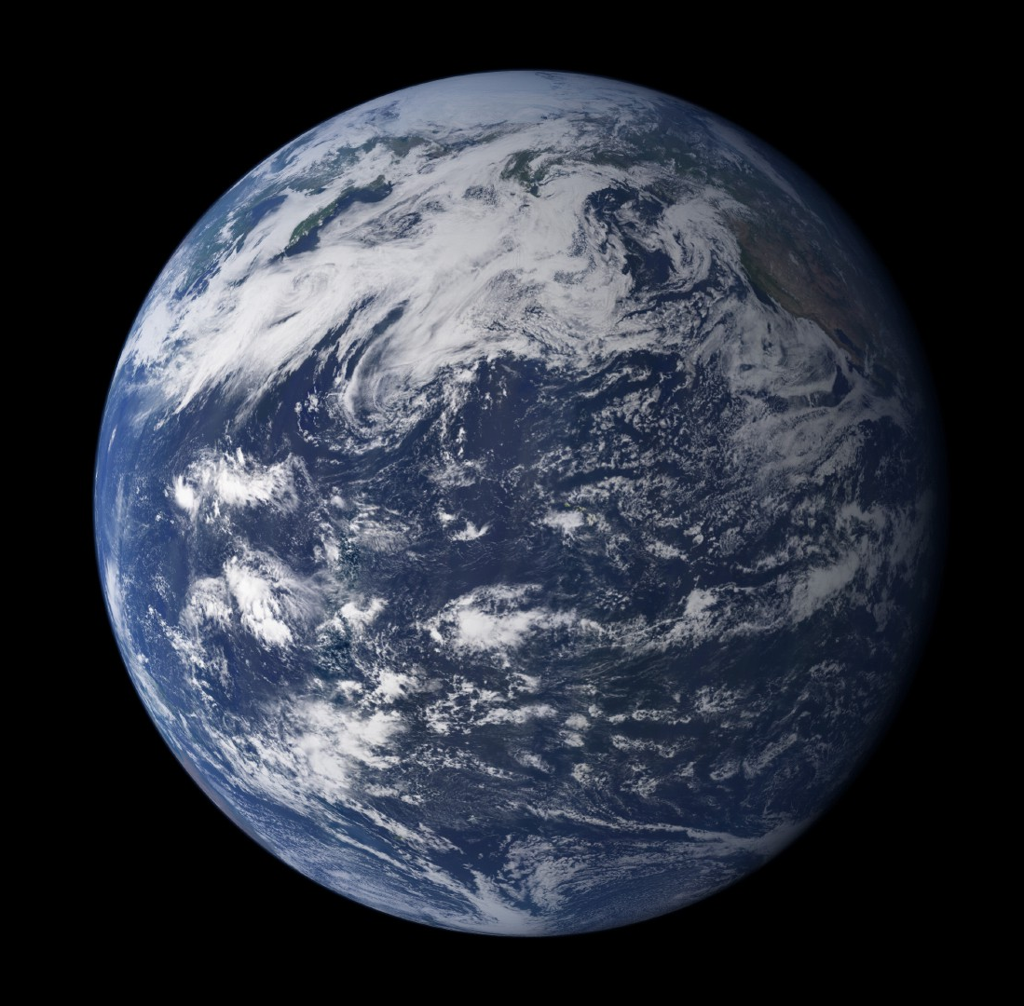
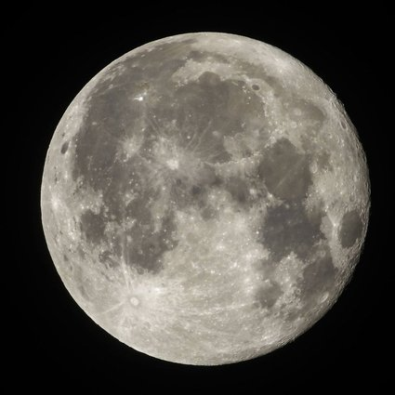
Earth
Tidally Locked
Planets
Asteroid Belt
Kuiper Belt
Oort Cloud
Notes:
This is my experimental setup. (click) A signal generator is used to generate a signal that passed to (click) the speaker which plays the sound. (click) The disk is placed in front of the speaker and (click A decibel meter is used to accurately measure the intensity of the sound which is stored by (click) the datalogger. (click) The motion of the disk is recorded by a camera. (click)

Slide 11
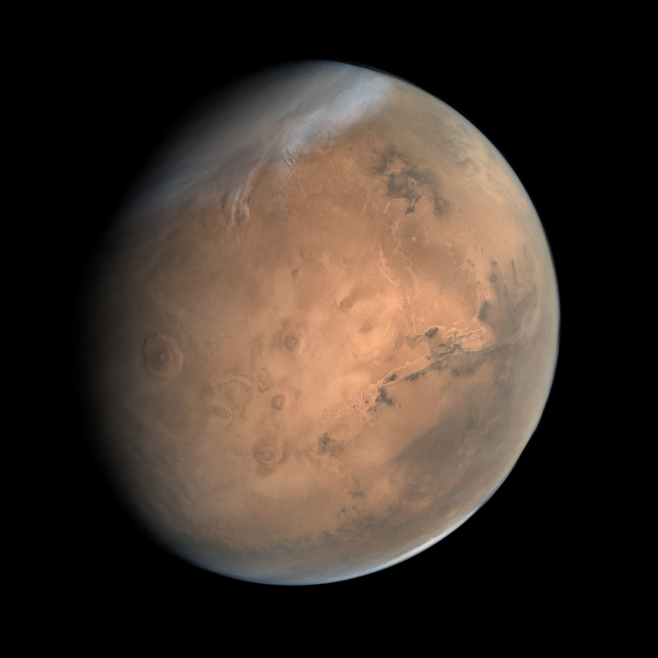
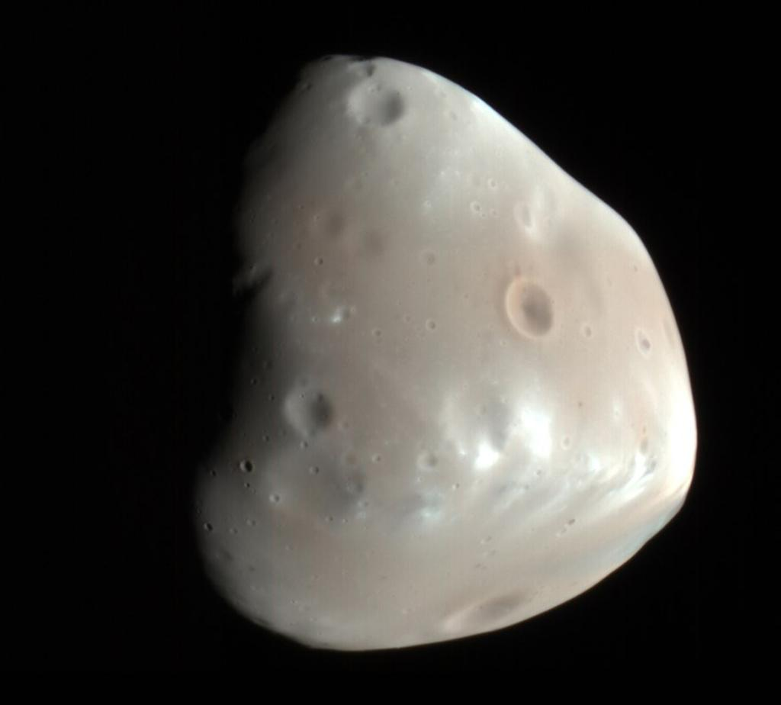
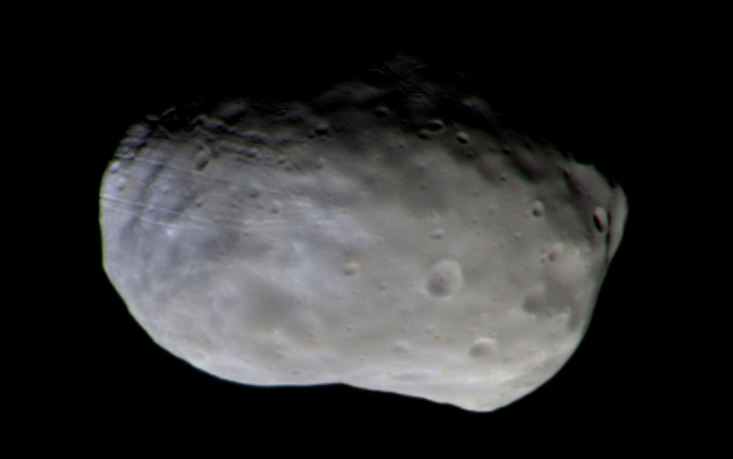
Mars
Ice Caps
Named after the Roman God of War
Very thin atmosphere
Mostly carbon dioxide
Surface is red due due to iron oxide (rust)
Deimos
Phobos
Planets
Asteroid Belt
Kuiper Belt
Oort Cloud
Notes:
This is my experimental setup. (click) A signal generator is used to generate a signal that passed to (click) the speaker which plays the sound. (click) The disk is placed in front of the speaker and (click A decibel meter is used to accurately measure the intensity of the sound which is stored by (click) the datalogger. (click) The motion of the disk is recorded by a camera. (click)

Slide 12
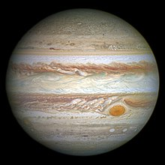
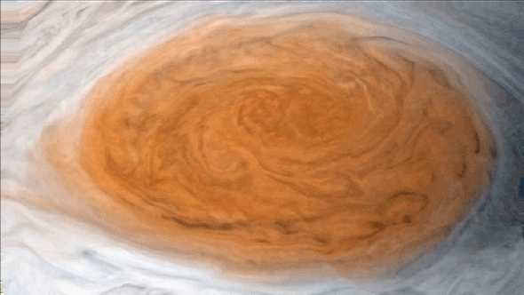
Jupiter
Named after the king of the Roman Gods
Largest planet in the solar system
Consists of hydrogen and helium – gas giant
The swirly things are storms
Great red spot
Planets
Asteroid Belt
Kuiper Belt
Oort Cloud
Notes:
This is my experimental setup. (click) A signal generator is used to generate a signal that passed to (click) the speaker which plays the sound. (click) The disk is placed in front of the speaker and (click A decibel meter is used to accurately measure the intensity of the sound which is stored by (click) the datalogger. (click) The motion of the disk is recorded by a camera. (click)

Slide 13
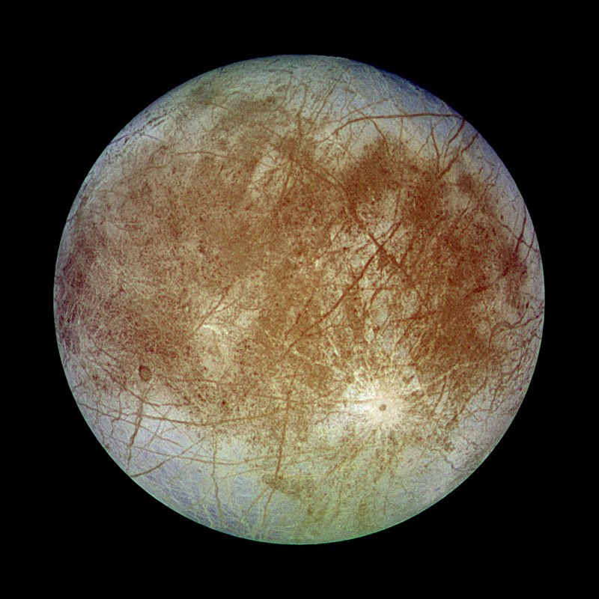
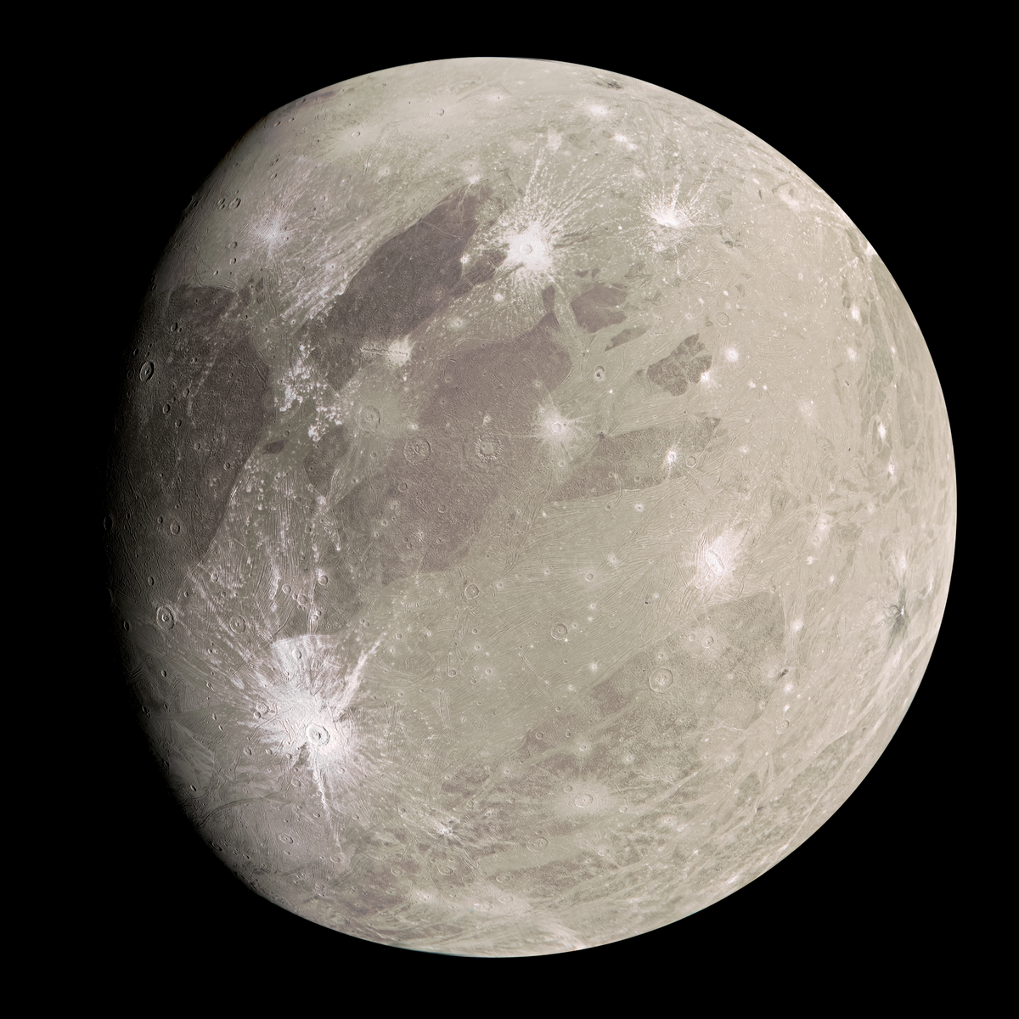
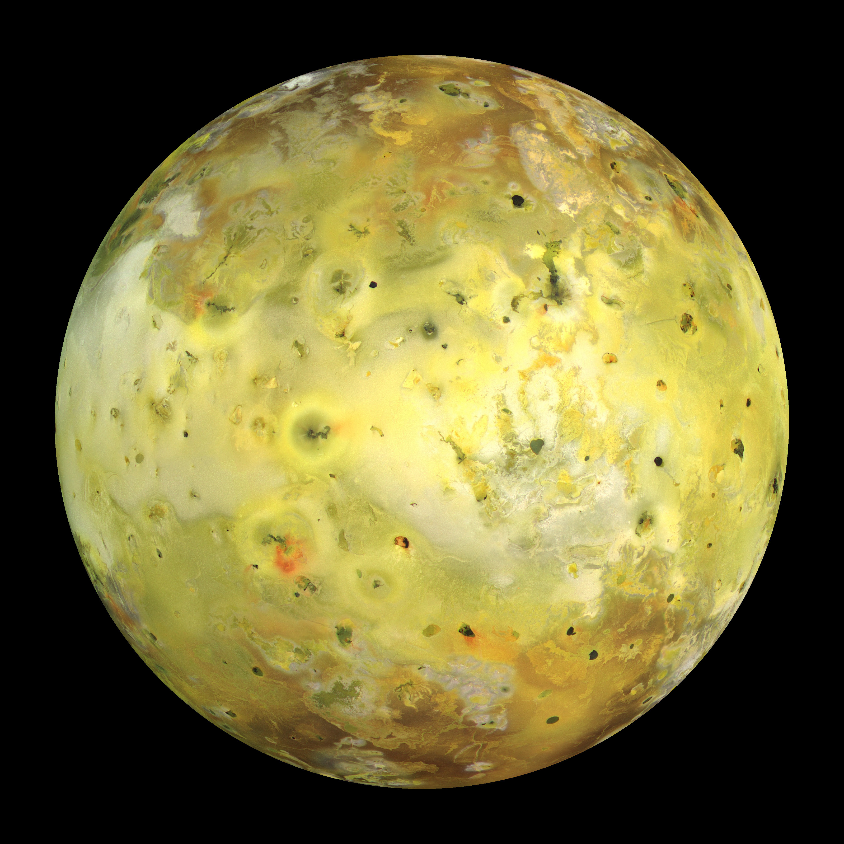
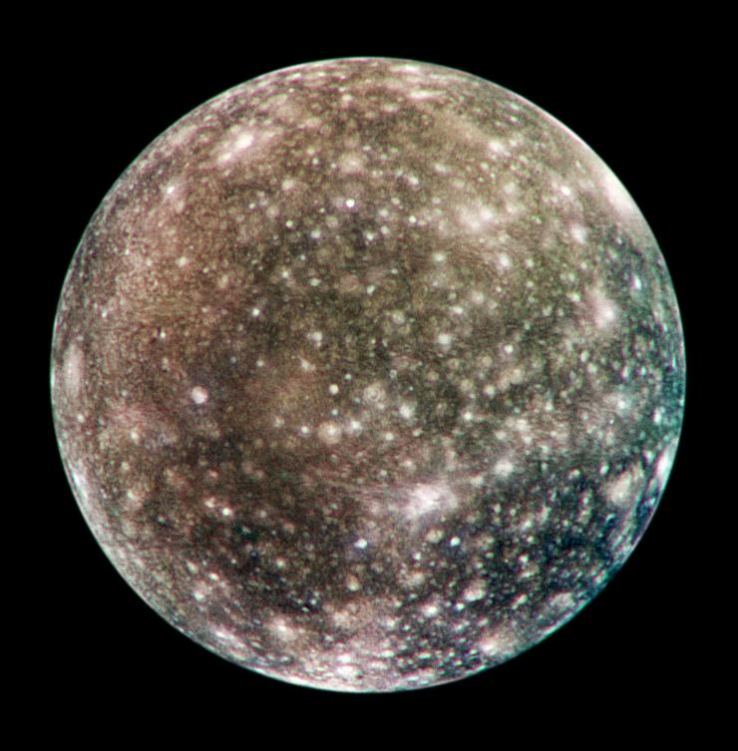
Jovian Moons
Planets
Asteroid Belt
Kuiper Belt
Oort Cloud
Notes:
This is my experimental setup. (click) A signal generator is used to generate a signal that passed to (click) the speaker which plays the sound. (click) The disk is placed in front of the speaker and (click A decibel meter is used to accurately measure the intensity of the sound which is stored by (click) the datalogger. (click) The motion of the disk is recorded by a camera. (click)

Slide 14
Europa
Thick icy crust
Red lines are cracks and ridges in the crust
Formed due to tidal forces acting on Europa
Planets
Asteroid Belt
Kuiper Belt
Oort Cloud
Notes:
This is my experimental setup. (click) A signal generator is used to generate a signal that passed to (click) the speaker which plays the sound. (click) The disk is placed in front of the speaker and (click A decibel meter is used to accurately measure the intensity of the sound which is stored by (click) the datalogger. (click) The motion of the disk is recorded by a camera. (click)

Slide 15
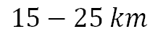
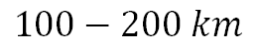
Europa
Ice
$$15−25 km$$
Ocean
$$100−200 km$$
Mantle
Planets
Asteroid Belt
Kuiper Belt
Oort Cloud
Notes:
This is my experimental setup. (click) A signal generator is used to generate a signal that passed to (click) the speaker which plays the sound. (click) The disk is placed in front of the speaker and (click A decibel meter is used to accurately measure the intensity of the sound which is stored by (click) the datalogger. (click) The motion of the disk is recorded by a camera. (click)

Slide 16
Jovian Moons
Planets
Asteroid Belt
Kuiper Belt
Oort Cloud
Notes:
This is my experimental setup. (click) A signal generator is used to generate a signal that passed to (click) the speaker which plays the sound. (click) The disk is placed in front of the speaker and (click A decibel meter is used to accurately measure the intensity of the sound which is stored by (click) the datalogger. (click) The motion of the disk is recorded by a camera. (click)

Slide 17
Ganymede
Largest moon in the solar system
Even larger than Mercury
Has its own magnetic field
Thin atmosphere of mostly oxygen
Planets
Asteroid Belt
Kuiper Belt
Oort Cloud
Notes:
This is my experimental setup. (click) A signal generator is used to generate a signal that passed to (click) the speaker which plays the sound. (click) The disk is placed in front of the speaker and (click A decibel meter is used to accurately measure the intensity of the sound which is stored by (click) the datalogger. (click) The motion of the disk is recorded by a camera. (click)

Slide 18
Jovian Moons
Planets
Asteroid Belt
Kuiper Belt
Oort Cloud
Notes:
This is my experimental setup. (click) A signal generator is used to generate a signal that passed to (click) the speaker which plays the sound. (click) The disk is placed in front of the speaker and (click A decibel meter is used to accurately measure the intensity of the sound which is stored by (click) the datalogger. (click) The motion of the disk is recorded by a camera. (click)

Slide 19
Io
Most geologically active object in the solar system
Volcanos spew sulfur compounds everywhere
Volcanism caused by tidal heating
Planets
Asteroid Belt
Kuiper Belt
Oort Cloud
Notes:
This is my experimental setup. (click) A signal generator is used to generate a signal that passed to (click) the speaker which plays the sound. (click) The disk is placed in front of the speaker and (click A decibel meter is used to accurately measure the intensity of the sound which is stored by (click) the datalogger. (click) The motion of the disk is recorded by a camera. (click)

Slide 20
Jovian Moons
Planets
Asteroid Belt
Kuiper Belt
Oort Cloud
Notes:
This is my experimental setup. (click) A signal generator is used to generate a signal that passed to (click) the speaker which plays the sound. (click) The disk is placed in front of the speaker and (click A decibel meter is used to accurately measure the intensity of the sound which is stored by (click) the datalogger. (click) The motion of the disk is recorded by a camera. (click)

Slide 21
Callisto
Many impact craters – White spots
Thin atmosphere of carbon dioxide
Planets
Asteroid Belt
Kuiper Belt
Oort Cloud
Notes:
This is my experimental setup. (click) A signal generator is used to generate a signal that passed to (click) the speaker which plays the sound. (click) The disk is placed in front of the speaker and (click A decibel meter is used to accurately measure the intensity of the sound which is stored by (click) the datalogger. (click) The motion of the disk is recorded by a camera. (click)

Slide 22
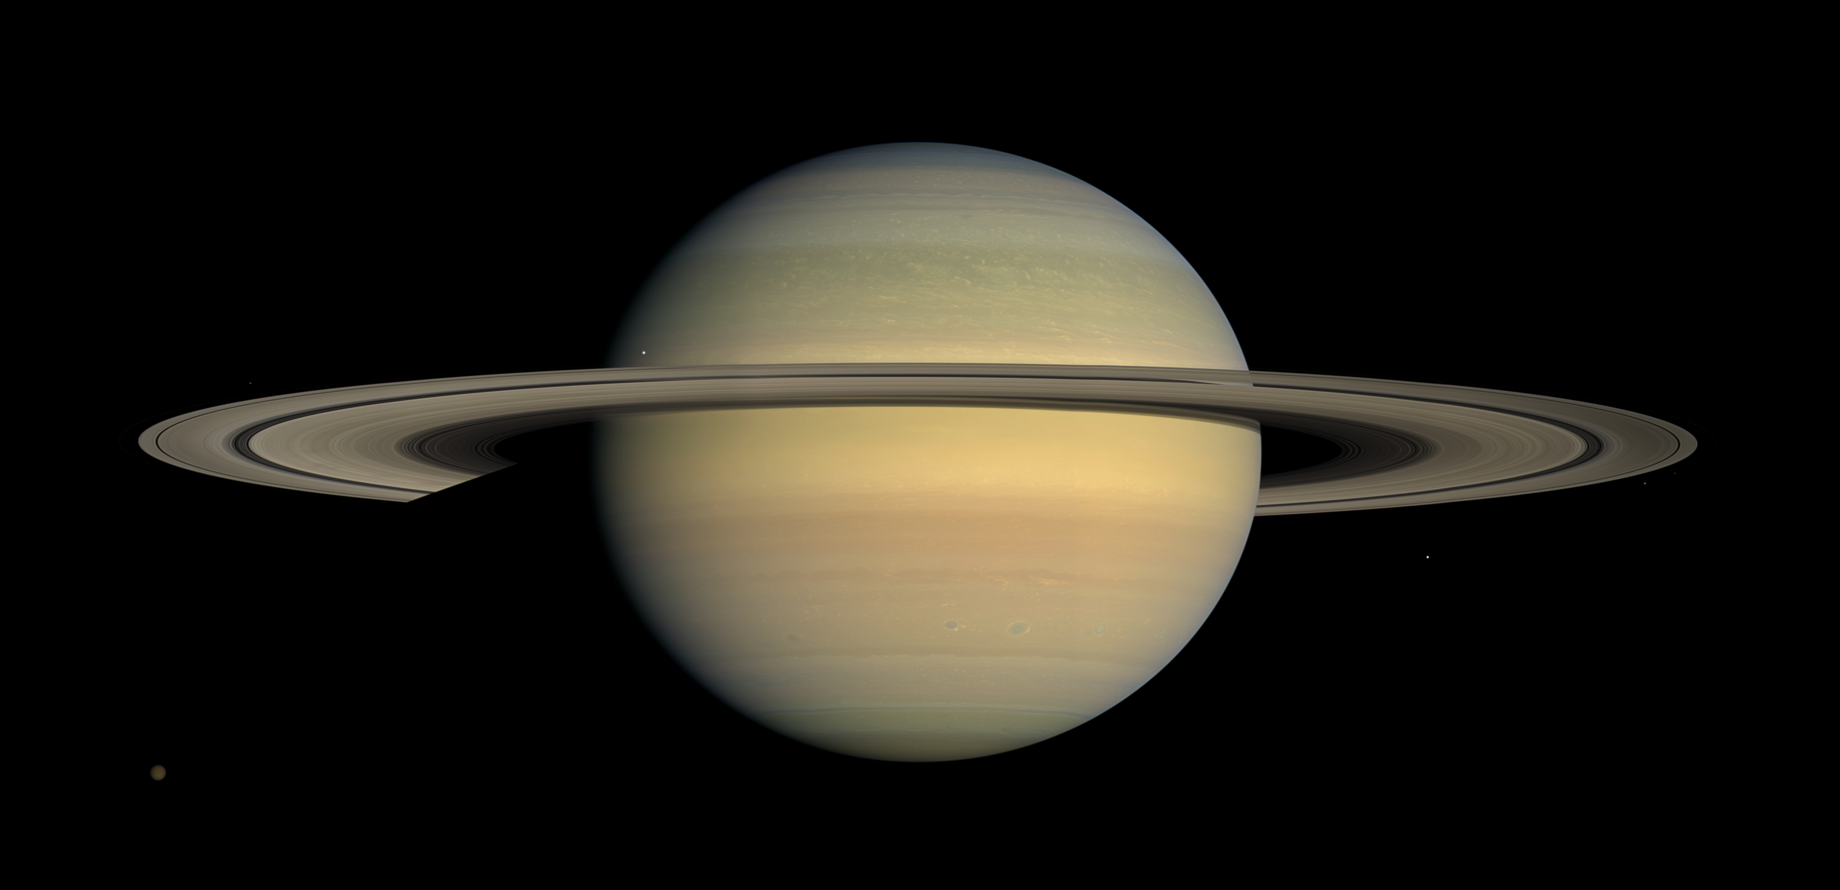
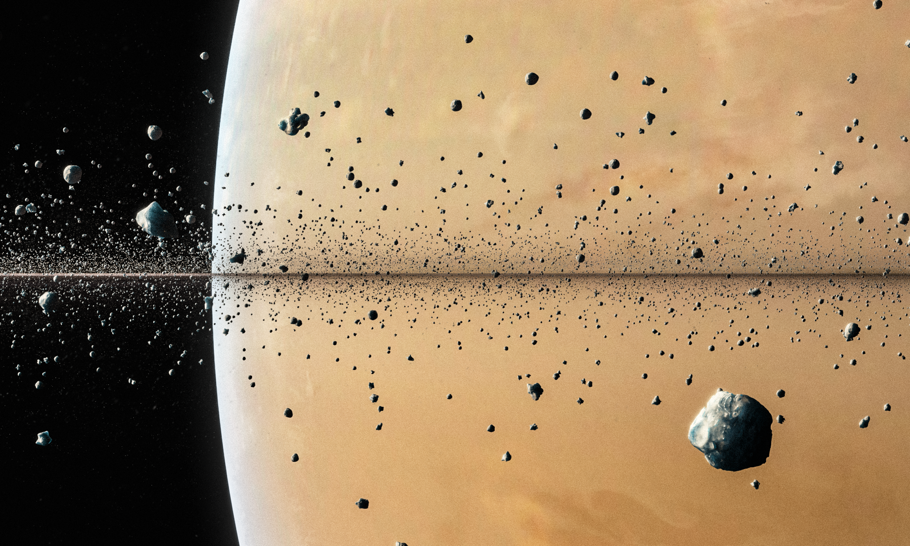
Saturn
Inside the rings
Gas giant – lighter than water
Pale yellow hue due to ammonia crystals in its upper atmosphere
Planets
Asteroid Belt
Kuiper Belt
Oort Cloud
Notes:
This is my experimental setup. (click) A signal generator is used to generate a signal that passed to (click) the speaker which plays the sound. (click) The disk is placed in front of the speaker and (click A decibel meter is used to accurately measure the intensity of the sound which is stored by (click) the datalogger. (click) The motion of the disk is recorded by a camera. (click)

Slide 23
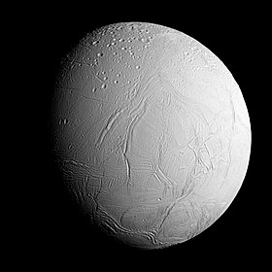
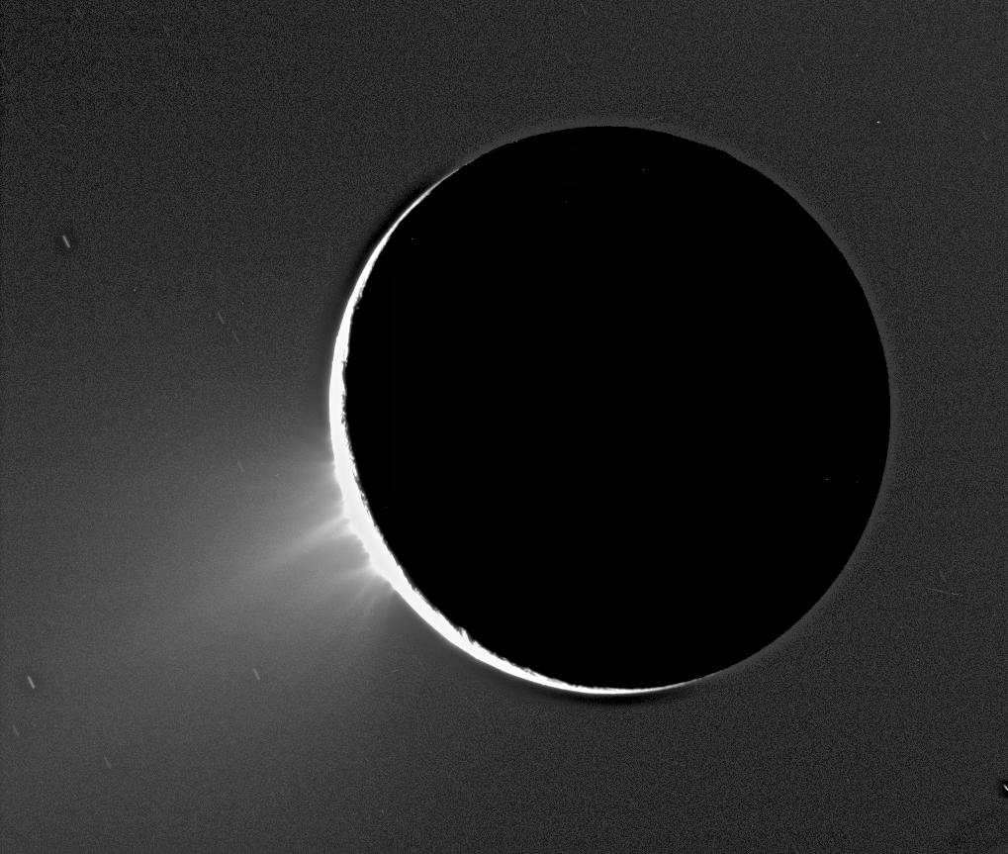
Enceladus
Icy moon of Saturn
Likely geologically active
Frequently ejects plumes of water and hydrogen
Possible sub-surface ocean with microbial life
Cryovolcanism
Planets
Asteroid Belt
Kuiper Belt
Oort Cloud
Notes:
This is my experimental setup. (click) A signal generator is used to generate a signal that passed to (click) the speaker which plays the sound. (click) The disk is placed in front of the speaker and (click A decibel meter is used to accurately measure the intensity of the sound which is stored by (click) the datalogger. (click) The motion of the disk is recorded by a camera. (click)

Slide 24
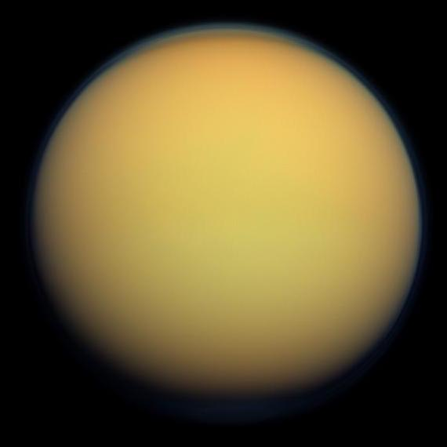
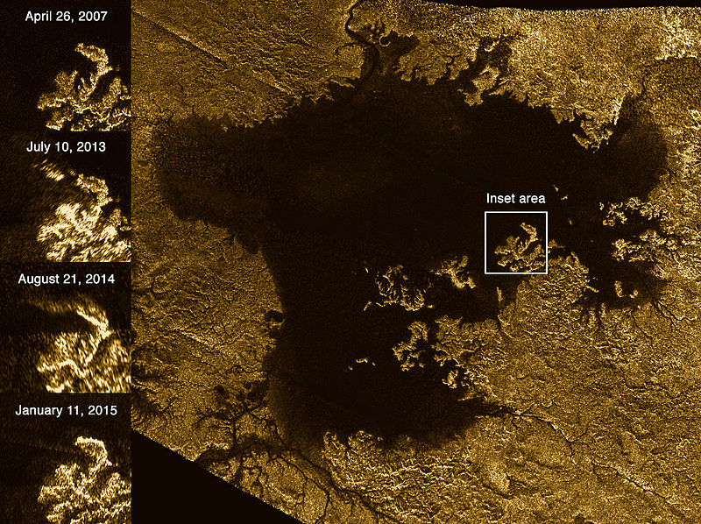
Titan
Primarily composed of icy and rocky material
Atmosphere is mostly nitrogen at 1.45 atm
Orange due to dense organonitrogen haze
Methane cycle instead of water cycle
Hydrocarbon seas
Methane clouds
Could possibly harbour life not based on water
Methane Seas
Planets
Asteroid Belt
Kuiper Belt
Oort Cloud
Notes:
This is my experimental setup. (click) A signal generator is used to generate a signal that passed to (click) the speaker which plays the sound. (click) The disk is placed in front of the speaker and (click A decibel meter is used to accurately measure the intensity of the sound which is stored by (click) the datalogger. (click) The motion of the disk is recorded by a camera. (click)

Slide 25
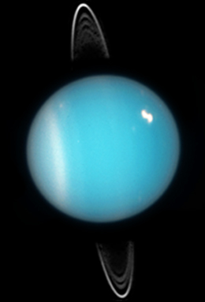
Uranus
Another gas giant
Contains methane which makes it blue
The other planet with rings
Planets
Asteroid Belt
Kuiper Belt
Oort Cloud
Notes:
This is my experimental setup. (click) A signal generator is used to generate a signal that passed to (click) the speaker which plays the sound. (click) The disk is placed in front of the speaker and (click A decibel meter is used to accurately measure the intensity of the sound which is stored by (click) the datalogger. (click) The motion of the disk is recorded by a camera. (click)

Slide 26
Uranus
!
Extreme tilt of almost 90°
Planets
Asteroid Belt
Kuiper Belt
Oort Cloud
Notes:
This is my experimental setup. (click) A signal generator is used to generate a signal that passed to (click) the speaker which plays the sound. (click) The disk is placed in front of the speaker and (click A decibel meter is used to accurately measure the intensity of the sound which is stored by (click) the datalogger. (click) The motion of the disk is recorded by a camera. (click)

Slide 27
Extreme Tilt
Planets
Asteroid Belt
Kuiper Belt
Oort Cloud
Notes:
This is my experimental setup. (click) A signal generator is used to generate a signal that passed to (click) the speaker which plays the sound. (click) The disk is placed in front of the speaker and (click A decibel meter is used to accurately measure the intensity of the sound which is stored by (click) the datalogger. (click) The motion of the disk is recorded by a camera. (click)

Slide 28
Extreme Tilt
KABOOM!!!!
Planets
Asteroid Belt
Kuiper Belt
Oort Cloud
Notes:
This is my experimental setup. (click) A signal generator is used to generate a signal that passed to (click) the speaker which plays the sound. (click) The disk is placed in front of the speaker and (click A decibel meter is used to accurately measure the intensity of the sound which is stored by (click) the datalogger. (click) The motion of the disk is recorded by a camera. (click)

Slide 29
Extreme Tilt
Planets
Asteroid Belt
Kuiper Belt
Oort Cloud
Notes:
This is my experimental setup. (click) A signal generator is used to generate a signal that passed to (click) the speaker which plays the sound. (click) The disk is placed in front of the speaker and (click A decibel meter is used to accurately measure the intensity of the sound which is stored by (click) the datalogger. (click) The motion of the disk is recorded by a camera. (click)

Slide 30
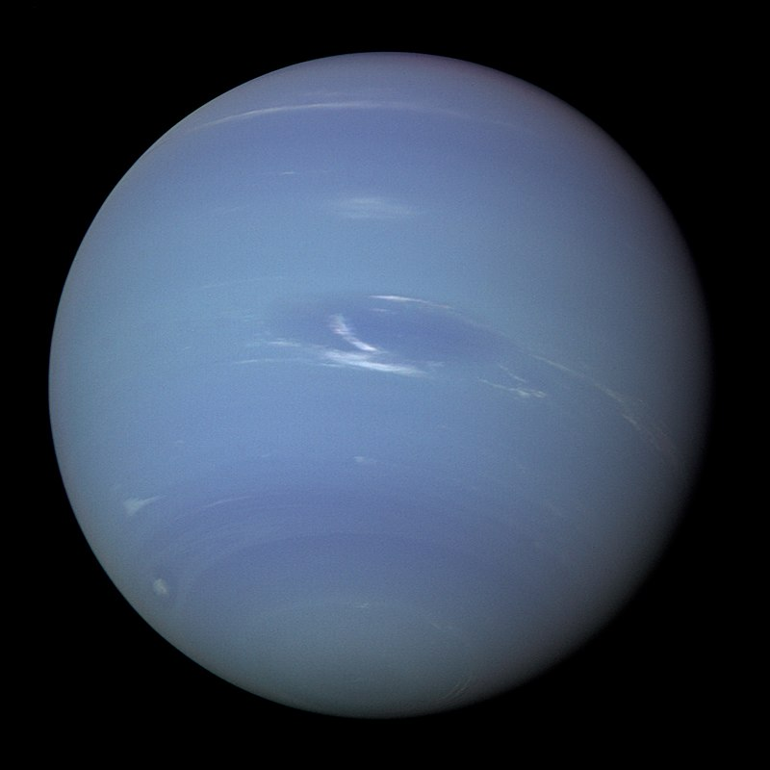
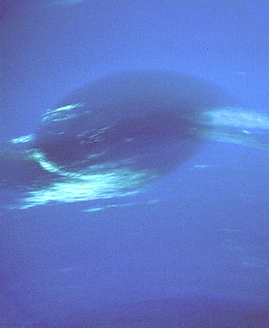
Neptune
Methane makes it blue and an unknown compound is suspected to make it even more blue.
Great Dark Spot
Planets
Asteroid Belt
Kuiper Belt
Oort Cloud
Notes:
This is my experimental setup. (click) A signal generator is used to generate a signal that passed to (click) the speaker which plays the sound. (click) The disk is placed in front of the speaker and (click A decibel meter is used to accurately measure the intensity of the sound which is stored by (click) the datalogger. (click) The motion of the disk is recorded by a camera. (click)

Slide 31
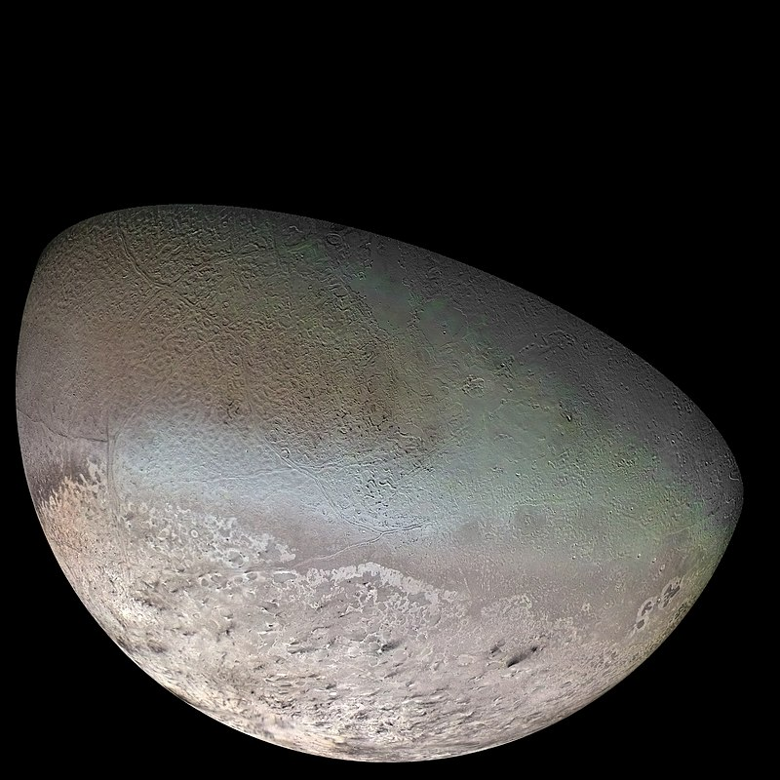
Triton
A moon of Neptune
The only moon that orbits in retrograde
Proposed that Triton is a captured KBO
Planets
Asteroid Belt
Kuiper Belt
Oort Cloud
Notes:
This is my experimental setup. (click) A signal generator is used to generate a signal that passed to (click) the speaker which plays the sound. (click) The disk is placed in front of the speaker and (click A decibel meter is used to accurately measure the intensity of the sound which is stored by (click) the datalogger. (click) The motion of the disk is recorded by a camera. (click)

Slide 32
Asteroid Belt
Planets
Asteroid Belt
Kuiper Belt
Oort Cloud
Notes:
Let’s take a look at why. (click)

Slide 33
Asteroid
Asteroid
A minor planet orbiting the Sun
Generally rocky / metallic bodies
Meteor
Asteroid / comet that enters the Earth’s atmosphere
Meteoroid
A small piece of a meteor that lands on the Earth’s surface
Planets
Asteroid Belt
Kuiper Belt
Oort Cloud
Notes:
To understand the origin of the torque on the disk, we will consider the sound wave hitting the disk. We can plot the pressure at (click) point A and (click) point B. We note that the pressures are out of phase. In the first region, (click) we note that the torque acting on the disk is clockwise while in the (click) 2nd region, the torque acting on the disk is anti-clockwise. (click) Taking the time-average torque, we note that it is zero as the sound wave is sinusoidal. Thus, the initial sound wave cannot account for the torque of the disk. (click)

Slide 34
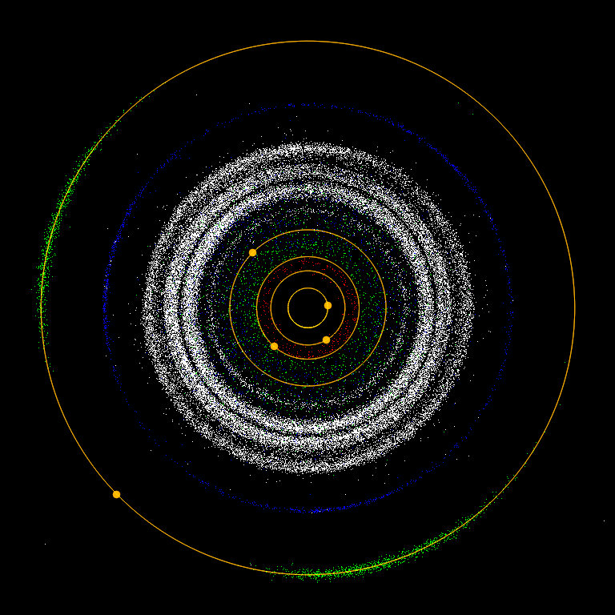
Asteroid Belt
A region of the solar system between the orbits of Jupiter and Mars which contains many asteroids
Planets
Asteroid Belt
Kuiper Belt
Oort Cloud
Notes:
To understand the origin of the torque on the disk, we will consider the sound wave hitting the disk. We can plot the pressure at (click) point A and (click) point B. We note that the pressures are out of phase. In the first region, (click) we note that the torque acting on the disk is clockwise while in the (click) 2nd region, the torque acting on the disk is anti-clockwise. (click) Taking the time-average torque, we note that it is zero as the sound wave is sinusoidal. Thus, the initial sound wave cannot account for the torque of the disk. (click)

Slide 35
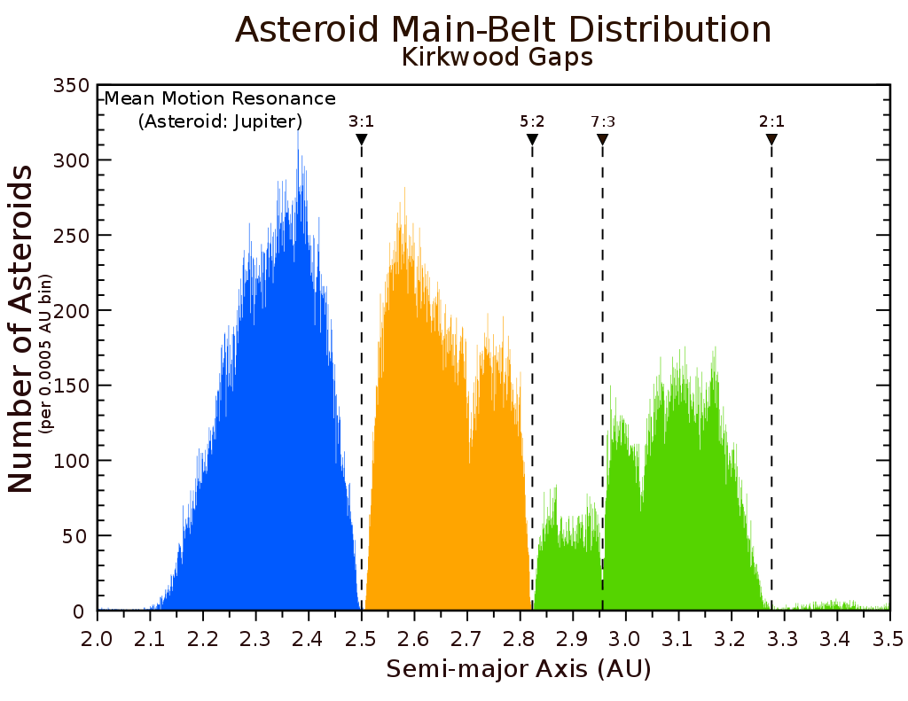
Kirkwood Gaps
Planets
Asteroid Belt
Kuiper Belt
Oort Cloud
Notes:
To understand the origin of the torque on the disk, we will consider the sound wave hitting the disk. We can plot the pressure at (click) point A and (click) point B. We note that the pressures are out of phase. In the first region, (click) we note that the torque acting on the disk is clockwise while in the (click) 2nd region, the torque acting on the disk is anti-clockwise. (click) Taking the time-average torque, we note that it is zero as the sound wave is sinusoidal. Thus, the initial sound wave cannot account for the torque of the disk. (click)

Slide 36
Orbital Resonance
Planets
Asteroid Belt
Kuiper Belt
Oort Cloud
Notes:
To understand the origin of the torque on the disk, we will consider the sound wave hitting the disk. We can plot the pressure at (click) point A and (click) point B. We note that the pressures are out of phase. In the first region, (click) we note that the torque acting on the disk is clockwise while in the (click) 2nd region, the torque acting on the disk is anti-clockwise. (click) Taking the time-average torque, we note that it is zero as the sound wave is sinusoidal. Thus, the initial sound wave cannot account for the torque of the disk. (click)

Slide 37
Trojan Asteroids
Found at the Lagrange points of the Jupiter-Sun System
Lagrange points are a set of points where a small mass body can orbit under the influence of 2 larger mass bodies
Planets
Asteroid Belt
Kuiper Belt
Oort Cloud
Notes:
To understand the origin of the torque on the disk, we will consider the sound wave hitting the disk. We can plot the pressure at (click) point A and (click) point B. We note that the pressures are out of phase. In the first region, (click) we note that the torque acting on the disk is clockwise while in the (click) 2nd region, the torque acting on the disk is anti-clockwise. (click) Taking the time-average torque, we note that it is zero as the sound wave is sinusoidal. Thus, the initial sound wave cannot account for the torque of the disk. (click)

Slide 38
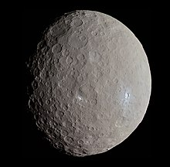
Ceres
Largest asteroid in the Solar System
Classified as a dwarf planet
Planets
Asteroid Belt
Kuiper Belt
Oort Cloud
Notes:
To understand the origin of the torque on the disk, we will consider the sound wave hitting the disk. We can plot the pressure at (click) point A and (click) point B. We note that the pressures are out of phase. In the first region, (click) we note that the torque acting on the disk is clockwise while in the (click) 2nd region, the torque acting on the disk is anti-clockwise. (click) Taking the time-average torque, we note that it is zero as the sound wave is sinusoidal. Thus, the initial sound wave cannot account for the torque of the disk. (click)

Slide 39
Kuiper Belt
Planets
Asteroid Belt
Kuiper Belt
Oort Cloud
Notes:
Now, we will attempt to quantitatively model this phenomenon. (click)

Slide 40
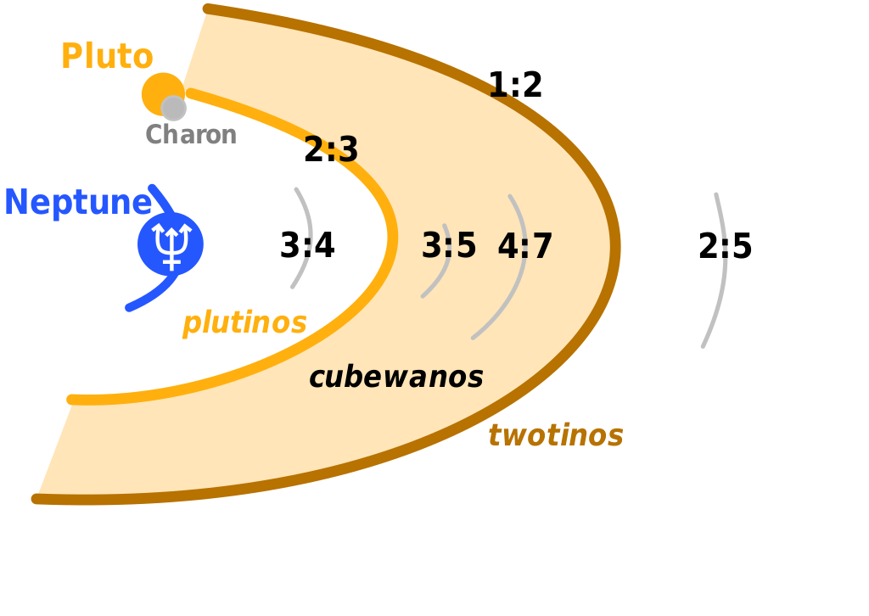
Kuiper Belt
Similar to the asteroid belt but larger and the bodies are icy rather than rocky. It exists beyond the orbit of Neptune.
Objects in the Kuiper Belt are known as Kuiper Belt Objects (KBOs).
Planets
Asteroid Belt
Kuiper Belt
Oort Cloud

Slide 41
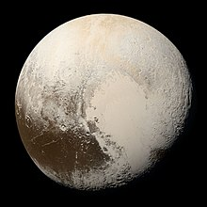
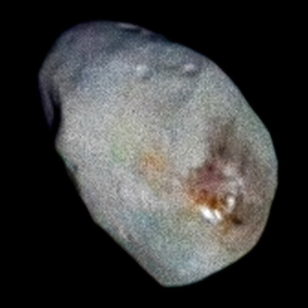
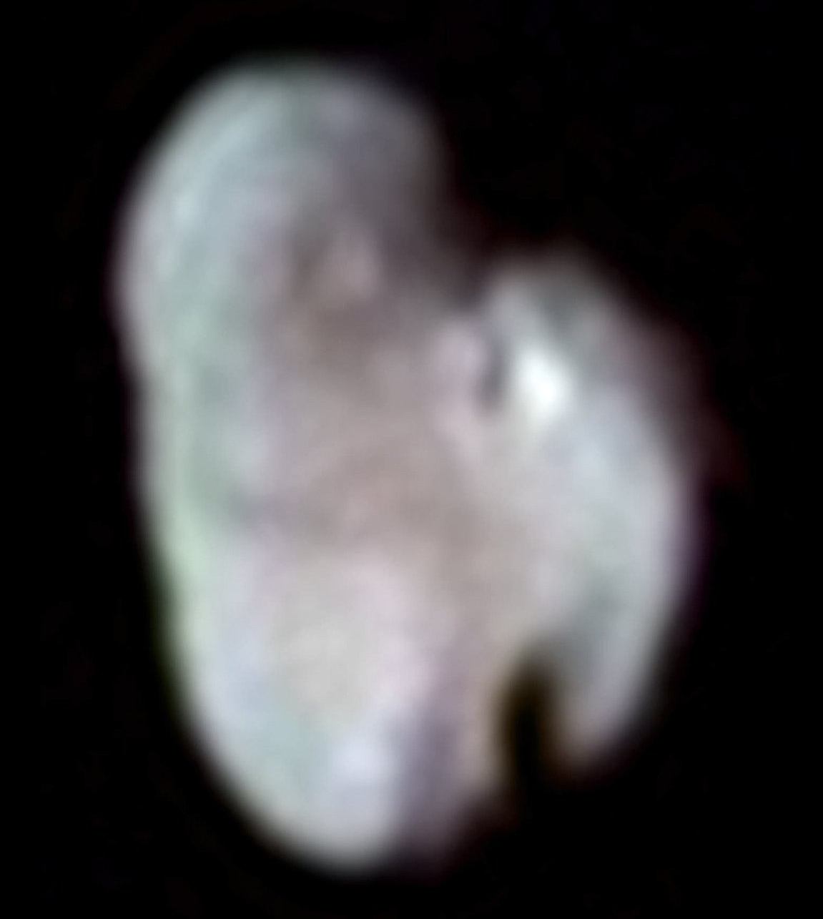
Pluto
Not a planet ☹
A dwarf planet in the Kuiper Belt
4 Moons
Hydra
Nix
Planets
Asteroid Belt
Kuiper Belt
Oort Cloud

Slide 42
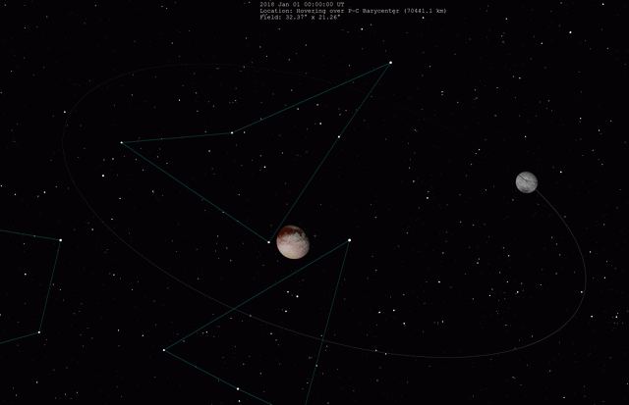
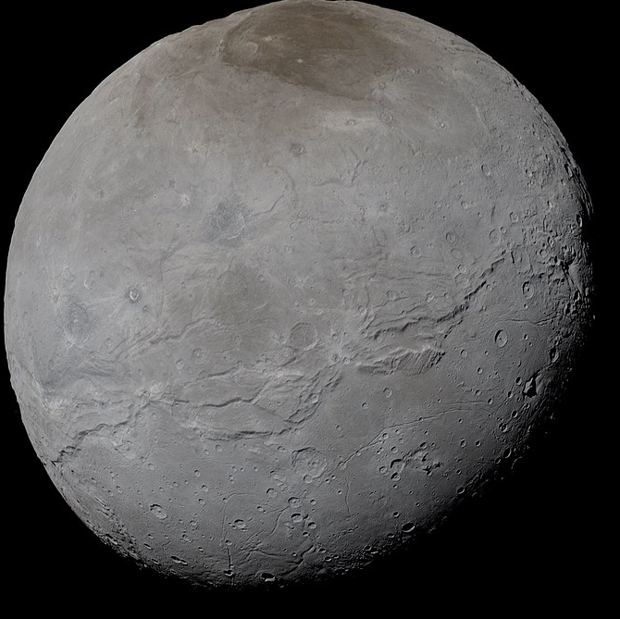
Pluto and Charon
Centre of Mass
Planets
Asteroid Belt
Kuiper Belt
Oort Cloud

Slide 43
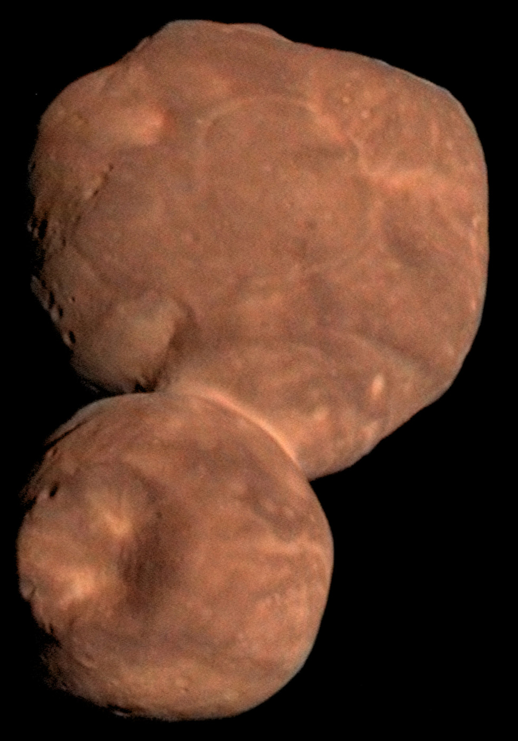
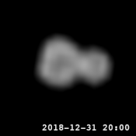
Arrokoth
Visited by New Horizons in 2019
Contact binary
2 objects that touch and rotate together
Contact Binary
Planets
Asteroid Belt
Kuiper Belt
Oort Cloud

Slide 44
Oort Cloud
Planets
Asteroid Belt
Kuiper Belt
Oort Cloud

Slide 45
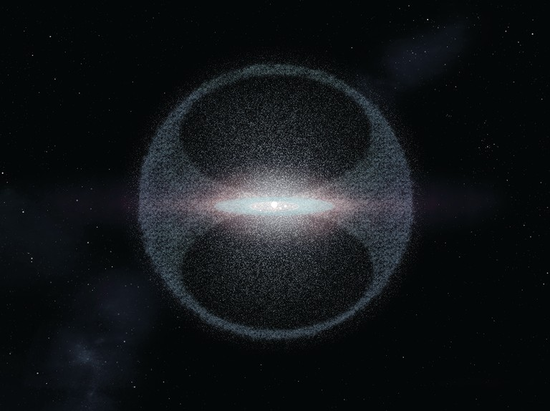
Oort Cloud
Comets come from the Oort Cloud / Kuiper Belt
Planets
Asteroid Belt
Kuiper Belt
Oort Cloud

Slide 46
Comets
Solar Wind
Mostly made of ice, have tails blown away by the solar wind
Planets
Asteroid Belt
Kuiper Belt
Oort Cloud

